Slide 1
Crossplane Deepdive Updated 1 August 2021
Notes:
Recorded session

Slide 2
Crossplane > Agenda
Crossplane?
Goals with Crossplane
Q&A
Composing & offering infrastructure
Concepts
Notes:
2 days workshop

Slide 3

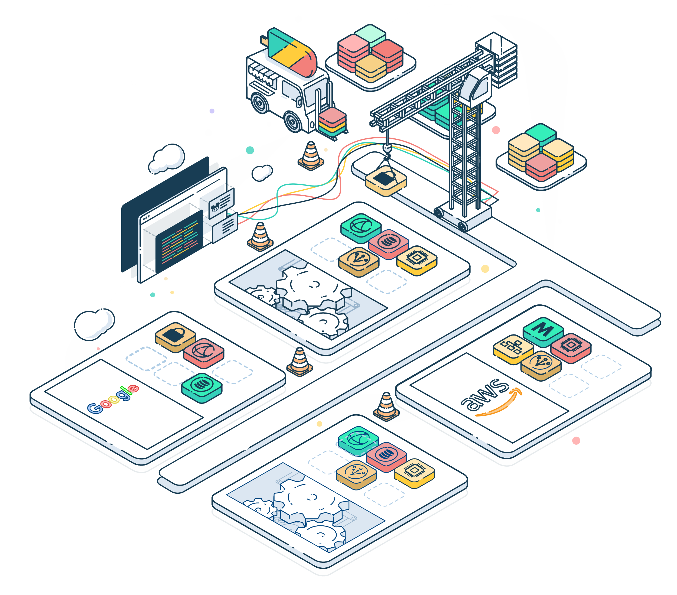

Crossplane > Extending Kubernetes with Crossplane
Managing and Provisioning infrastructure via the Kubernetes API
Open source
Crossplatform + Controlplane = Crossplane
Bassam Tabara is the founder of the Upbound Company behind the Crossplane project

Slide 4
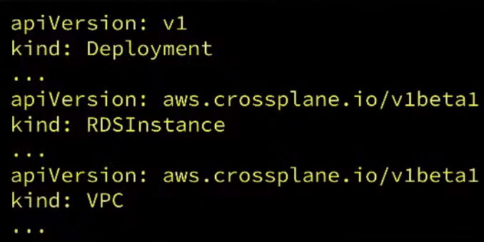
Crossplane > Why > Developer perspective
Use a consistent API for Workloads and Infrastructure
Single workflow for deploying software and all dependencies (including the infrastructure)
A vendor can now give customers a resource bundle (Helm, Kustomize, etc.) that includes the infrastructure that the application depends on!

Slide 5

Crossplane > Why > Operation / Platform builder perspective
Allows building a Control Plane that:
Uses an API that already exists in the organization (Kubernetes)
Out-of-the-box features:
Drift detection
Policy Enforcement
Access Control
Maintaining flexibility
- Extending to providing custom solutions
Abstraction and Self-service experience!

Slide 6
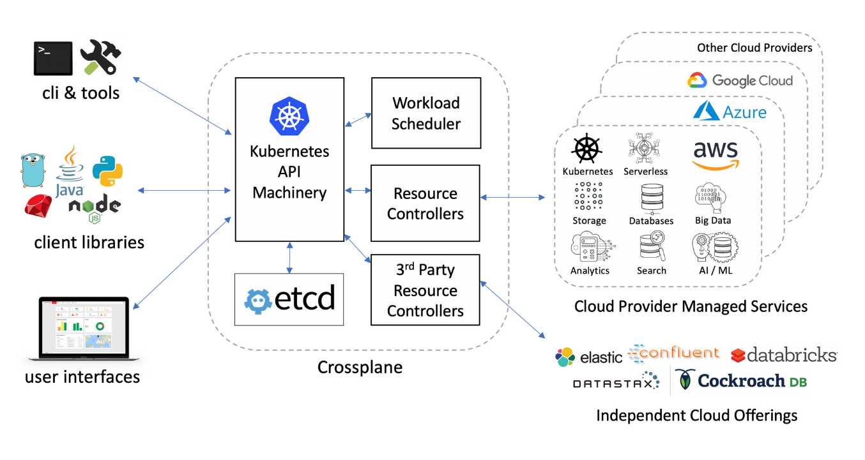
Crossplane > How does it work?
Existing tools and frameworks
Use Kubectl, GitOps, or any tools that can talk with the Kubernetes API
Expressing infrastructure in a declarative way, fx YAML manifests
RESTFUL principles
Everything treated as resources in the API (CRDs)
Well defined apis
Standard CRUD operations; GET, UPDATE, DELETE,..
Security and policies can be applied at resource level rather than the workspace level
RBAC
Extension via compositions
Granular resources can be composed into opinionated custome resources and easily consumed by developers e.g. using claim model
Minimal impact from refactoring work
Changes and Upgrades can be done behind the scenes without impacting end users
Dynamic resource provisioning
Eventual consistency model allows creating resources asynchronously
Kubernetes is responsible of keeping track of resource provisioning rather than relying on the pipeline.
No risk of drifting
Reconciliation loop ensures that resources always stays in desired state

Slide 7
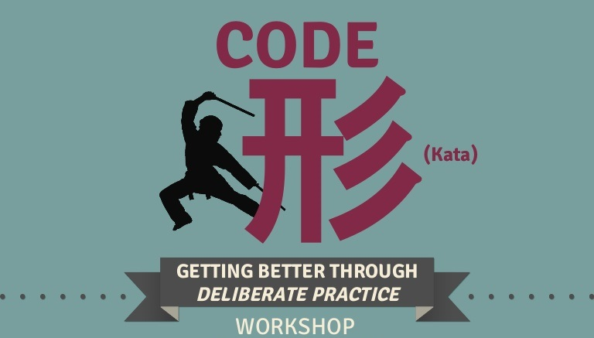
Crossplane > Code Kata #1
Notes:
install and configure crossplane in k8s cluster

Slide 8
Crossplane > Basics
Extension points:
Providers: extends the kubernetes API with managed resources (e.g. provider-aws, provider-gcp, provider-sql, provider-helm, etc.)
Resources: Resources from a provider that are mapped to actual resources from the specific vendor of that provider, written as CRDs
Kind: CloudSQLInsteance
provider-gcp
Controllers
Compositions: Combines multiple resources into larger components that allow defining abstract interfaces, and dependencies on Providers and other Compositions.
Configurations: distributable packages of Compositions and define dependencies on Providers and other Configurations
my-abstraction
Kind: CompositeRessourceDefinition
Kind: Composition
Eanbles composing and offering infrastructure

Slide 9
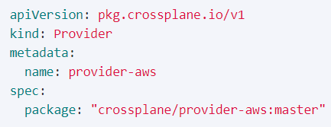

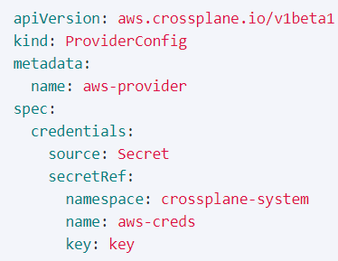
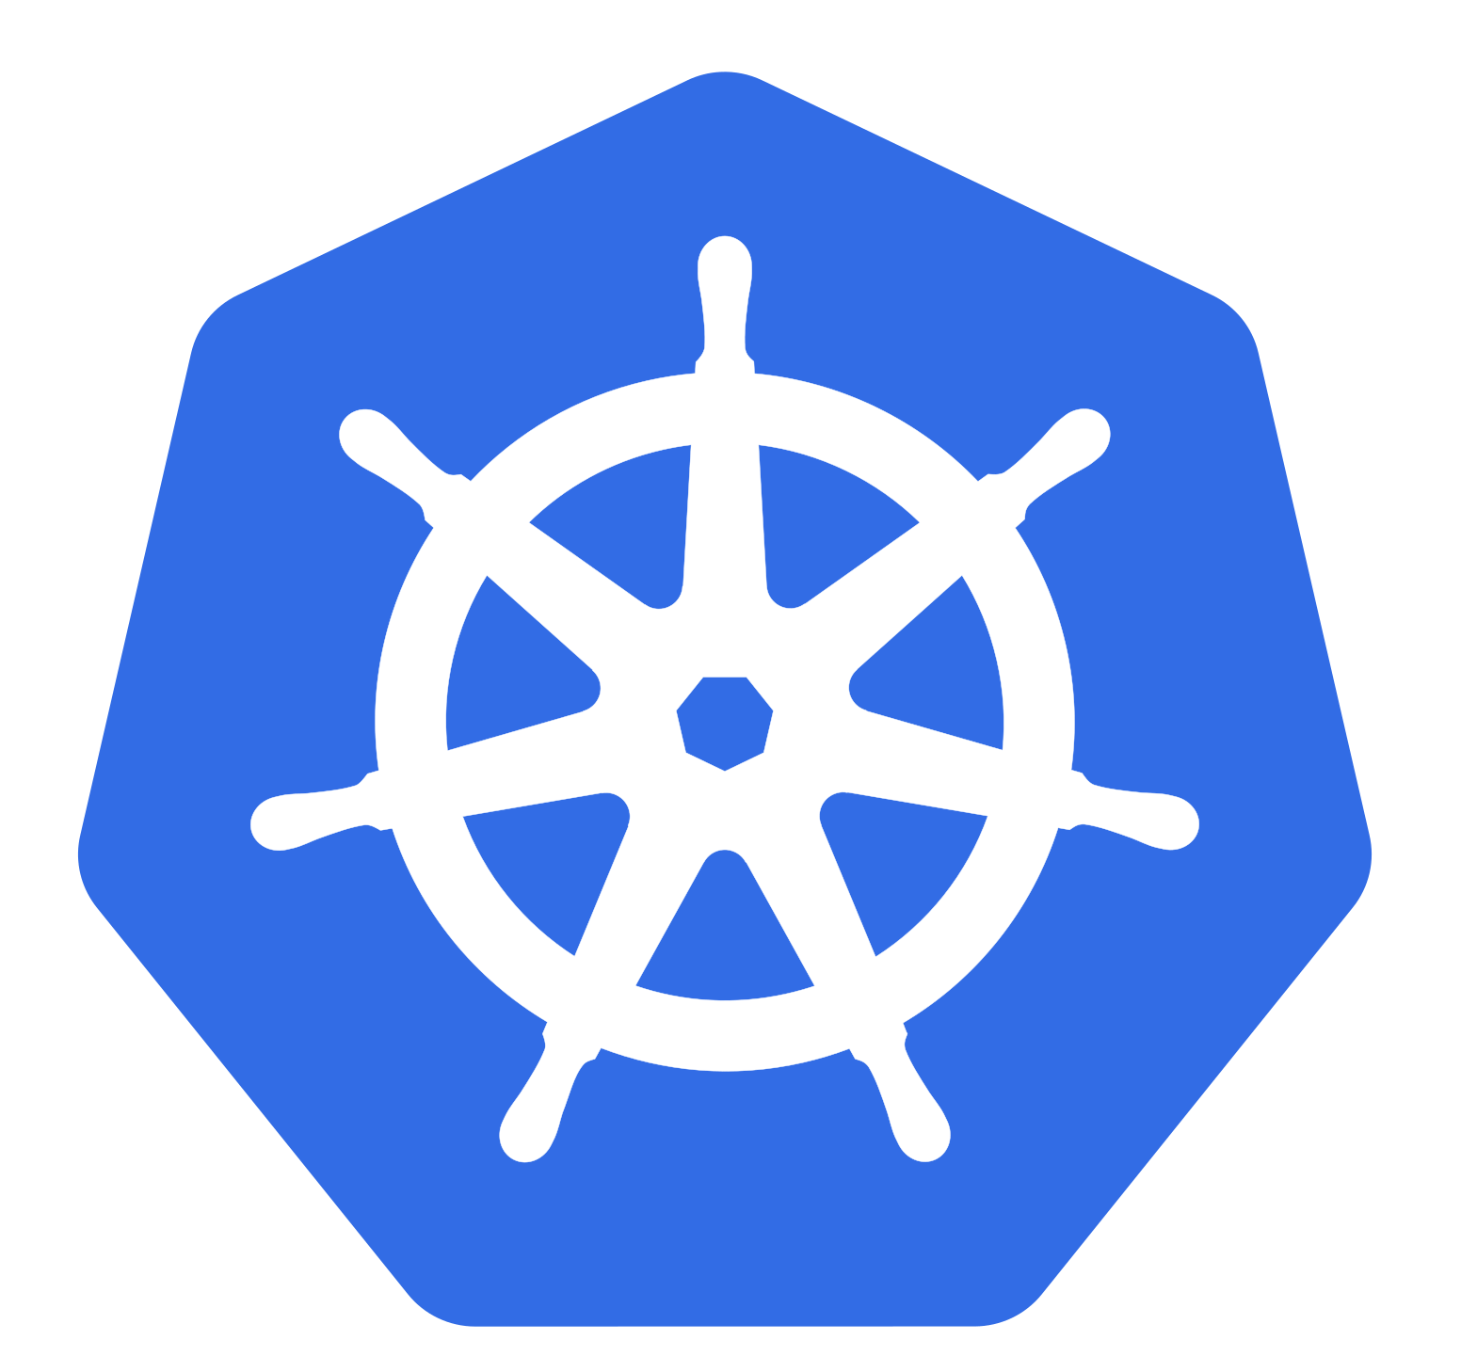
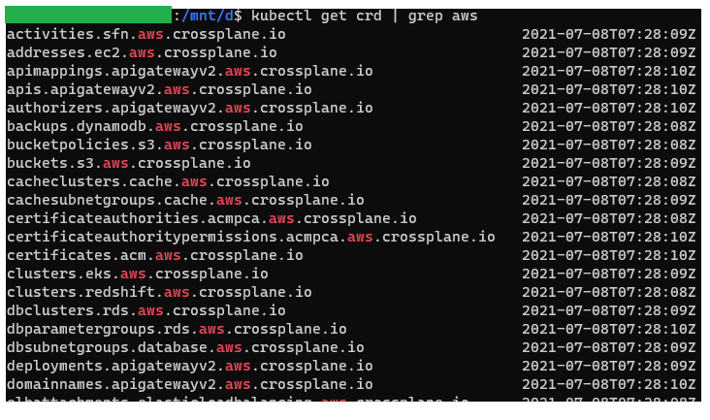
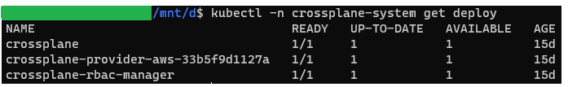
Crossplane > Basics > Providers
Plugin makes resources of a vendor available to be controlled by the k8s API
Packaged as OCI compatible images
SQL
Provider
Authentication
Against provider
ProviderConfig
CRDs
k8s API
SQL
Provider
Azure
Provider
GCP
Provider
AWS
Provider
is also a CRD!
Controller
Database
Database
instance
Database
instance
RDS
instance
Role
Network
Rule
Network
Rule
Security-Group
Resource reconciliation
Blob Storage
Bucket
S3Bucket

Slide 10
Crossplane > Code Kata #2
Notes:
Installing Provider package
Validating the provider

Slide 11
Crossplane > Code Kata #3
Notes:
Deploying a providerConfig for the provider

Slide 12


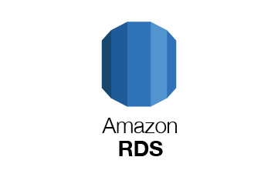

Crossplane > Basics > Resources
A mananged resource in kubernetes
Defined by a CRD
Represent a types of managed resources provided by the vendor
Enable conifuring new instances of managed resources
apiVersion: database.aws.crossplane.io/v1beta1
kind: RDSInstance
metadata:
name: my-database
spec:
forProvider:
region: eu-west-1
dbInstanceClass: db.t3.small
masterUsername: masteruser
allocatedStorage: 20
engine: postgresql
engineVersion: "13.3"
skipFinalSnapshotBeforeDeletion: true
providerConfigRef:
name: my-aws-provider-config
writeConnectionSecretToRef:
namespace: my-namespace
name: my-database-creds
Kubernetes API
Machinary
S3Bucket
CloudFront
RDSInstance

Slide 13
Crossplane > Code Kata #4
Notes:
Installing some aws resources

Slide 14

Crossplane > Part 1 > Q/A

Slide 15

Crossplane > Important note
Remember to clean up resources before going home!

Slide 16
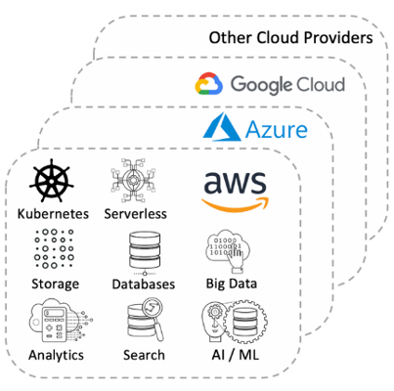
Crossplane > Composing infrastructure > Basics > Composite Resources
Provide abstractions on top of managed resources:
Combining multiple managed resources into larger components called Composite resources (XR)
Kind: CompositeResourceDefinition
my-abstraction
Composite resource (XR)
Kind: Composition
My-fancy-VM
My-awsome-database
My-k8s
Notes:
Examples of abstractions that you can build on top of the providers, could be custom sql database, configurable VM machines, or customized k8s clusters..etc

Slide 17
Crossplane > Composing infrastructure > Basics > Composite Resources > New XR
An XR is defined by a set of manifests:
Definition (XRD)
API Contract
OpenAPIv3 schema
Define the composite resource:
Fields to be exposed
The kind of resource to be used as a claim
Composition(s)
The implementation
Declares one kind of composite resource that it satisfies.
Specifies a “base” configuration for one or more composed resources.
Specifies “patches” that override values in the base. Those values come from parameters supplied by the instance of a defined composite resource.
Kind: CompositeResourceDefinition (XRD)
My-database-composite
XR
Kind: Composition
AWS Composition
Azure Composition
RDSInstance
SecurityGroup
MySQLServer
FirewallRule
Notes:
So compositions contain provider specific details.
you can have one for each vendor that you want to support in your system or
int theory, you could also have some mixture in these compositions; one could contain database from one provider and VPC from another provider..

Slide 18
Crossplane > Composing infrastructure > Basics > Composite Resources > Example
apiVersion: apiextensions.crossplane.io/v1
kind: Composition
metadata:
name: example-azure
labels:
purpose: example
provider: azure
spec:
compositeTypeRef:
apiVersion: example.org/v1alpha1
kind: CompositeMySQLInstance
resources:
- name: mysqlserver
base:
apiVersion: database.azure.crossplane.io/v1beta1
kind: MySQLServer
spec:
forProvider:
...
writeConnectionSecretToRef:
namespace: crossplane-system
patches:
- fromFieldPath: "spec.parameters.engineVersion"
toFieldPath: "spec.forProvider.engineVersion"
- ...
connectionDetails:
- fromConnectionSecretKey: username
- ...
readinessChecks:
- ...
- name: firewallrule
base:
apiVersion: database.azure.crossplane.io/v1alpha3
kind: MySQLServerFirewallRule
spec:
forProvider:
...
patches:
- ...
writeConnectionSecretsToNamespace: crossplane-system
apiVersion: apiextensions.crossplane.io/v1
kind: CompositeResourceDefinition
metadata:
name: compositemysqlinstances.example.org
spec:
connectionSecretKeys:
- username
- ... group: example.org
names:
kind: CompositeMySQLInstance
plural: compositemysqlinstances
claimNames:
kind: MySQLInstance
plural: mysqlinstances
versions:
- name: v1alpha1
...
schema:
openAPIV3Schema:
type: object
properties:
spec:
type: object
properties:
type: object
properties:
engineVersion:
description: Database engine version
type: string
...
required:
- parameters
Composition
The defintion

Slide 19
Crossplane > Code Kata #5
Notes:
Composing infrastructure and creating some XRDs

Slide 20
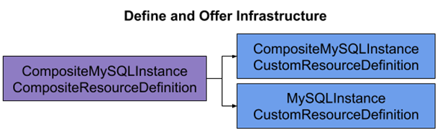
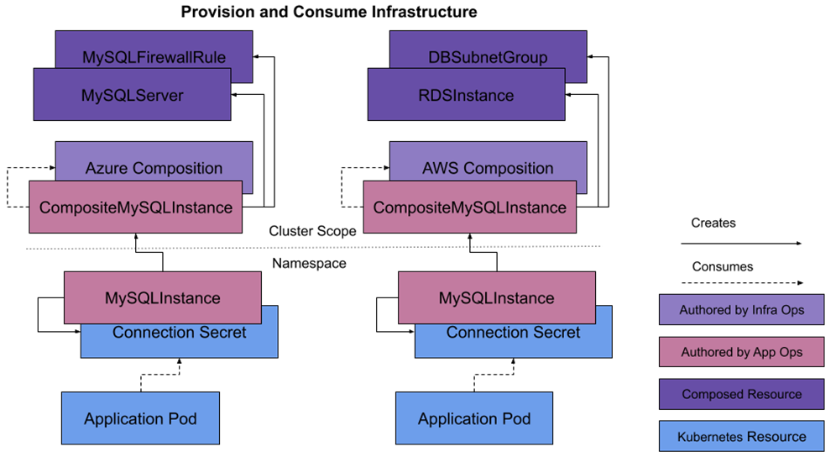
Crossplane > Define and offer infrastructure
2 CRDs
The claim
(if offered)
The instance
The actual implementation
(provider specifc)
User claims
Notes:
2 CRDs per composite resource: Definition for instances & for the claims. Claim is its own resource type so a CRD is needed for it.
Resources cluster scoped to allow using of existing resources that could be created by another team and intended to be a shared resource, like VPC. This is to enables namespaced infrastructure without violating namespace boundaries

Slide 21
Crossplane > Define and offer infrastructure > Claims
Claims (XRC) are a proxy for the kind of resource they claim
A claim may:
request a pre-provisioned Composite Resource(XR) -> (static provisioning),
or it may provision one on-demand -> (dynamic provisioning)
Notes:
Existing resource -> Static provisioning
Create new resource on-Demand -> dynamic provisioning

Slide 22
Crossplane > Compositions > Define and offer infrastructure > Claims > Example
apiVersion: apiextensions.crossplane.io/v1
kind: Composition
metadata:
name: example-azure
labels:
purpose: example
provider: azure
spec:
compositeTypeRef:
apiVersion: example.org/v1alpha1
kind: CompositeMySQLInstance
patchSets:
- name: external-name
patches:
- ...
resources:
- name: mysqlserver
base:
apiVersion: database.azure.crossplane.io/v1beta1
kind: MySQLServer
spec:
forProvider:
...
writeConnectionSecretToRef:
namespace: crossplane-system
patches:
- ...
connectionDetails:
- fromConnectionSecretKey: username
- ...
readinessChecks:
- ...
- name: firewallrule
base:
apiVersion: database.azure.crossplane.io/v1alpha3
kind: MySQLServerFirewallRule
spec:
forProvider:
...
patches:
- ...
writeConnectionSecretsToNamespace: crossplane-system
apiVersion: apiextensions.crossplane.io/v1
kind: CompositeResourceDefinition
metadata:
name: compositemysqlinstances.example.org
spec:
connectionSecretKeys:
- username
- ...
defaultCompositionRef:
name: example-azure
group: example.org
names:
kind: CompositeMySQLInstance
plural: compositemysqlinstances
claimNames:
kind: MySQLInstance
plural: mysqlinstances
versions:
- name: v1alpha1
...
schema:
openAPIV3Schema:
type: object
properties:
spec:
type: object
properties:
parameters:
...
required:
- parameters
apiVersion: example.org/v1alpha1
kind: MySQLInstance
metadata:
namespace: default
name: example
spec:
parameters:
location: au-east
storageGB: 20
version: "5.7"
compositionSelector:
matchLabels:
purpose: example
provider: azure
writeConnectionSecretToRef:
name: example-mysqlinstance
Composition
Claim (Dynamic)
The defintion

Slide 23
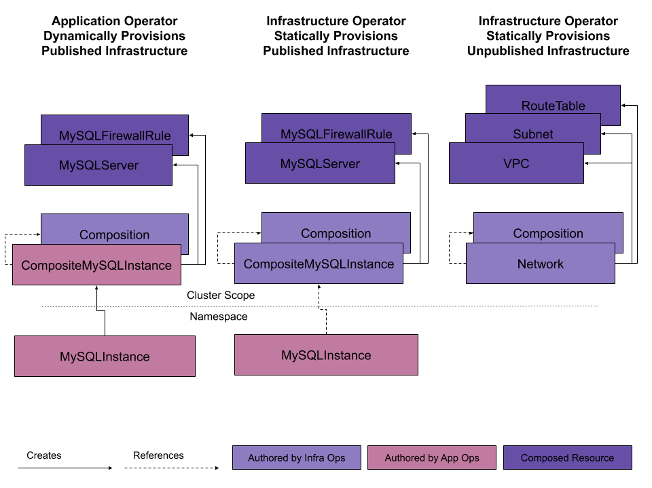
Crossplane > Define and offer infrastructure > Exposing XRs
Notes:
There are 3 ways to expose composite resources

Slide 24
Crossplane > Code Kata #6
Notes:
# 24 so let's head over and practice provisioning infrastructure with these 3 methods. Over to you Richard.
provisioning infrastructure..

Slide 25
Crossplane > Basics > Configurations
Package compositions into OCI compatible images
Can be composed of other packages
Installed as Configuration packages in k8s
Auto-install provider packages and any additional Configuration packages specified as dependency.
build the control plane
my-controlplane
my-databases
my-clusters
my-VMs
provider-gcp
provider-
on-prem
provider-helm
Notes:
Define how managed resources can be composed Can be published to a container registry

Slide 26
Crossplane > Code Kata #7
Notes:
Build and publishing configuration package

Slide 27


Crossplane > Abstraction and Self-service
Enabling infrastructure owners to build custom platform abstractions (APIs) composed of granular resources that allow developer self-service and service catalog use cases
Pipelines, CLI tools,
Consumes
Dev
Database composition
K8s composition
Other compositions..
The control plane
/ Abstraction layer
Ops
Uses
1) Deals with the complexities of the infrastructure configuration and security
2) Puts granular pieces into opinionated compositions to be easily consumed by Developers
Multi-cloud / Multi-region
eu-west-1
us-central1-f
east us
EKS instances
GKE instances
AKS instances
Infra Engineer
Network/Security
Network/Security
Network/Security
Database serices
Database serices
Database serices
Other cloud services
Other cloud services
Other cloud services
Notes:
3 different actors
Crossplane with un-opinionated resources provided by different vendors
then platform builders deals with the complexities of the infrastructure-configuration, security, etc. and these pieces together into more abstracted components to be consumed by the platform consumers

Slide 28
Crossplane > Code Kata #8
Notes:
consuming configuration packages

Slide 29
Crossplane > Interesting projects
Crossplane Provider for terraform - Consume Terraform modules from Crossplane composition:
https://github.com/crossplane-contrib/provider-terraform
Open Policy Agent (Gatekeeper) - Policy Enforcement
https://www.openpolicyagent.org/docs/latest/kubernetes-introduction/#what-is-opa-gatekeeper

Slide 30
Crossplane > Part 2 > Q/A

Slide 31
Crossplane > Important note
Remember to clean up resources before going home!

Slide 32
Crossplane > Resources
Crossplane official site
https://crossplane.io
Crossplane project side on Github
https://github.com/crossplane.
Composing Infrastructure guide
https://crossplane.io/docs/v1.3/concepts/composition.html
CRD and OpenAPIv3 https://kubernetes.io/docs/tasks/extend-kubernetes/custom-resources/custom-resource-definitions/
Slack Community
https://crossplane.slack.com
CRD documentation
https://doc.crds.dev

Slide 33
Crossplane > Feedback
https://forms.office.com/Pages/ResponsePage.aspx?id=ZpSpcwWtIUKfkOcUKqL2wTFclz-gNvpNq3THAj1j3ZxUMTExQjA2SEFOVjhGRVY3TFJTMk81SUUzSS4u

